Slide 1
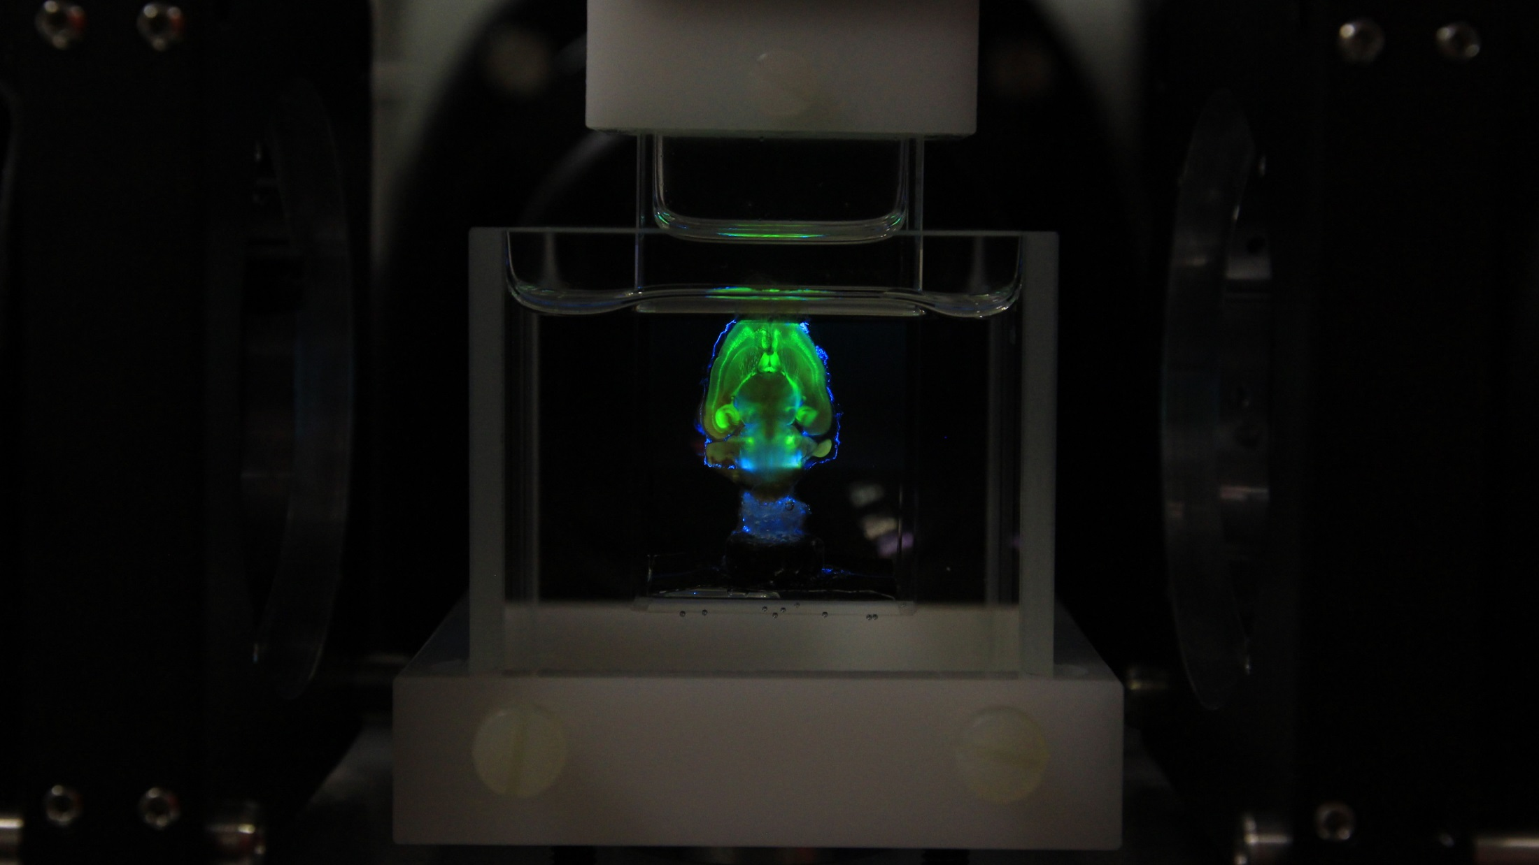
Zurich mesoSPIM documentation V3.10
Software version: commit: 25ac01
20.11.18

Slide 2
Part I: Specifications

Slide 3
FOV calibration
Objective Zoom FOV size (mm) Pixel size (mm)
1x 0.63 21.56 0.0105263
1x 0.8 16.86 0.008234
1x 1 13.42 0.006552
1x 1.25 10.79 0.0052666
1x 1.6 8.36 0.0040844
1x 2 6.69 0.0032688
1x 2.5 5.34 0.0026059
1x 3.2 4.16 0.0020332
1x 4 3.29 0.001606
1x 5 2.62 0.0012788
1x 6.3 2.12 0.0010348

Slide 4
Part II: Hardware overview

Slide 5
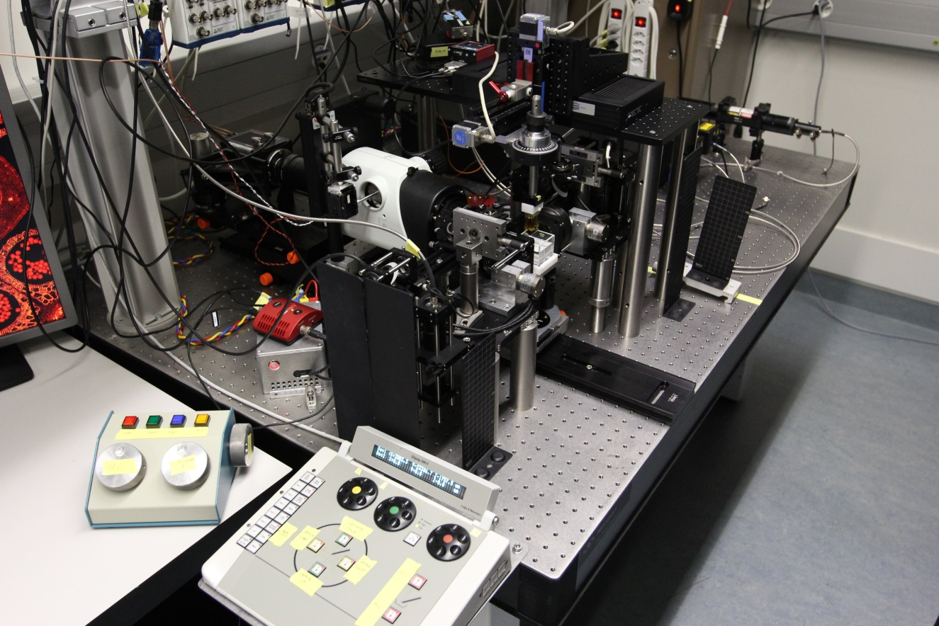
Microscope overview
Sample holder and
XYZ + rotation stages
Detection Path
Sample in a 20 mm
Cuvette (loading position)
Left Shutter Electronics
Right Excitation Unit
Left Galvo Electronics
Outer
cuvette
Sample Z & Microscope Z
Left Excitation Unit
Sample XY Movement controller

Slide 6
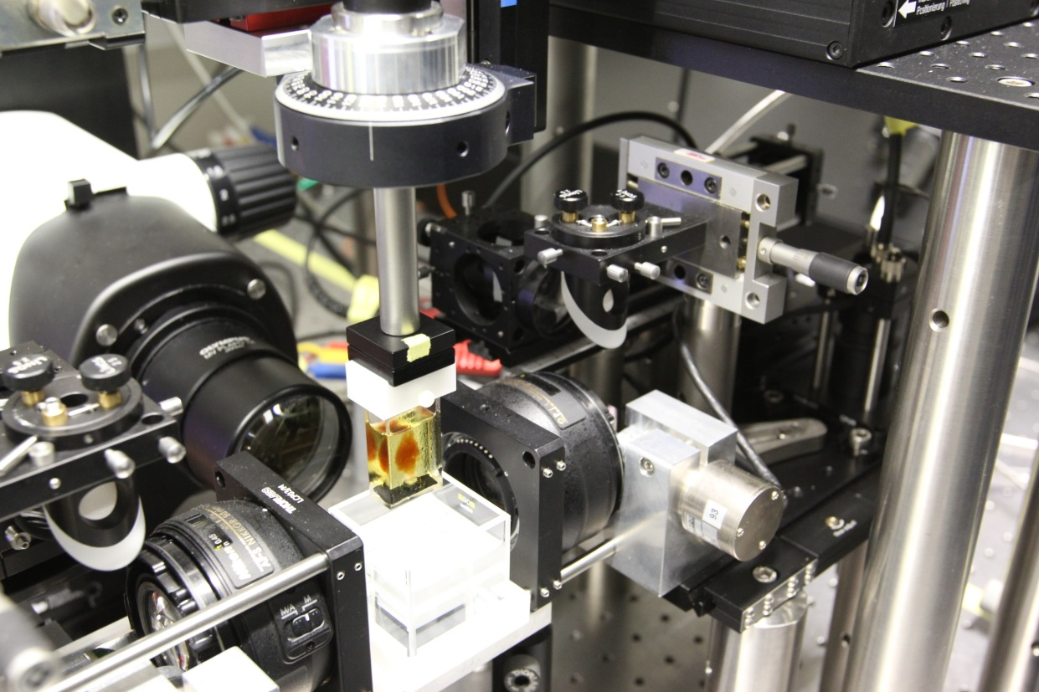

Overview of the sample holder
Rotation Stage
Iris diaphragm of the
detection system, leave
in the leftmost position!
Rotation Mark
1x Detection
objective
Left excitation
objective
Sample (badly cleared,
with some condensation
on the outer cuvette)
Outer
cuvette
Right excitation
objective
Right Galvanometric Mirror (Galvo)

Slide 7
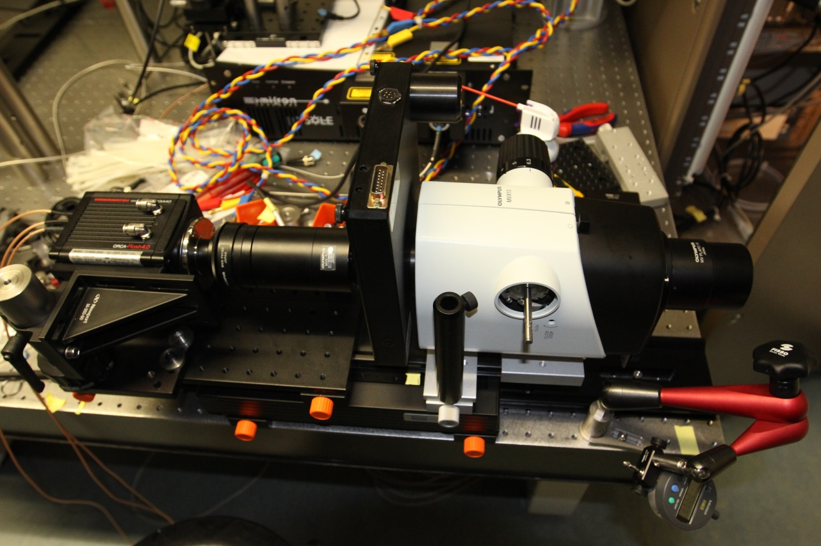
Overview of the detection system
10-position Filter wheel
Zoom wheel
0,63x-6,3x
(no manual
adjustments,
please use the
Zoom servo)
Iris diaphragm of the
detection system, leave
in open position!
Orca Flash
V3 Camera
(2048x2048 pix)
1x Objective
Tube lens
Microscope Z Stage
Flange for mounting the
Zoom Servo (not shown)

Slide 8
Part III: Learning to see with a light-sheet microscope

Slide 9
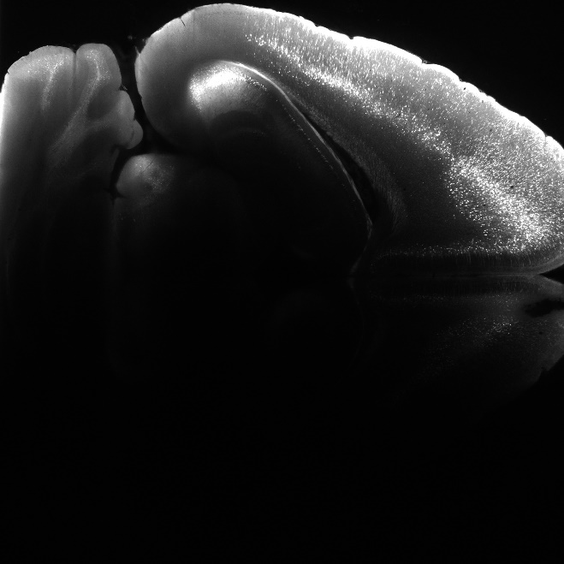
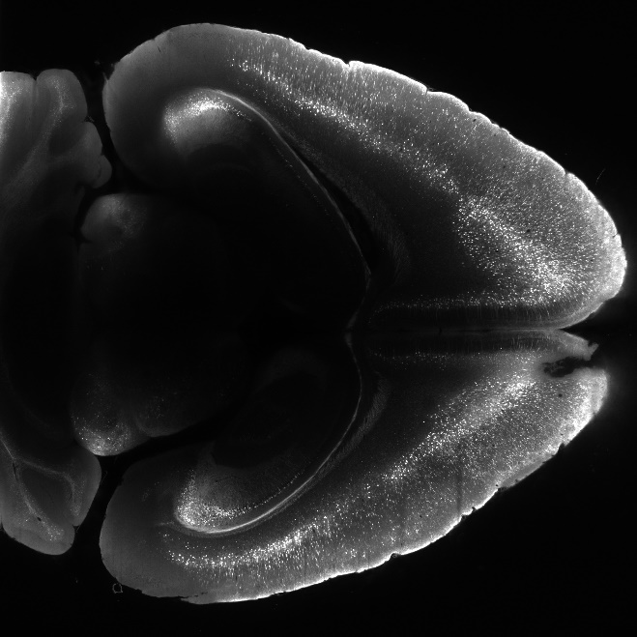
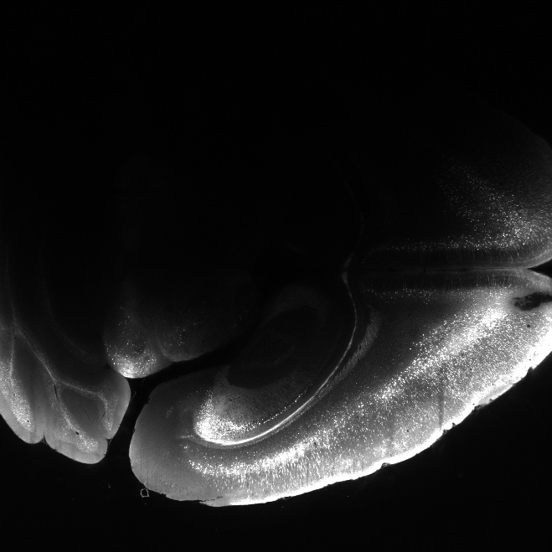
Light-sheet directions (@Zoom 1.25x)
Right
Bottom
Top
In order to allow the sweeping focus to be synchronized with the camera readout, the camera is rotated by 90º.
In not-so-well-cleared samples, the penetration direction is clearly visible:
Left
Right Light-sheet
Both
Left Light-sheet

Slide 10
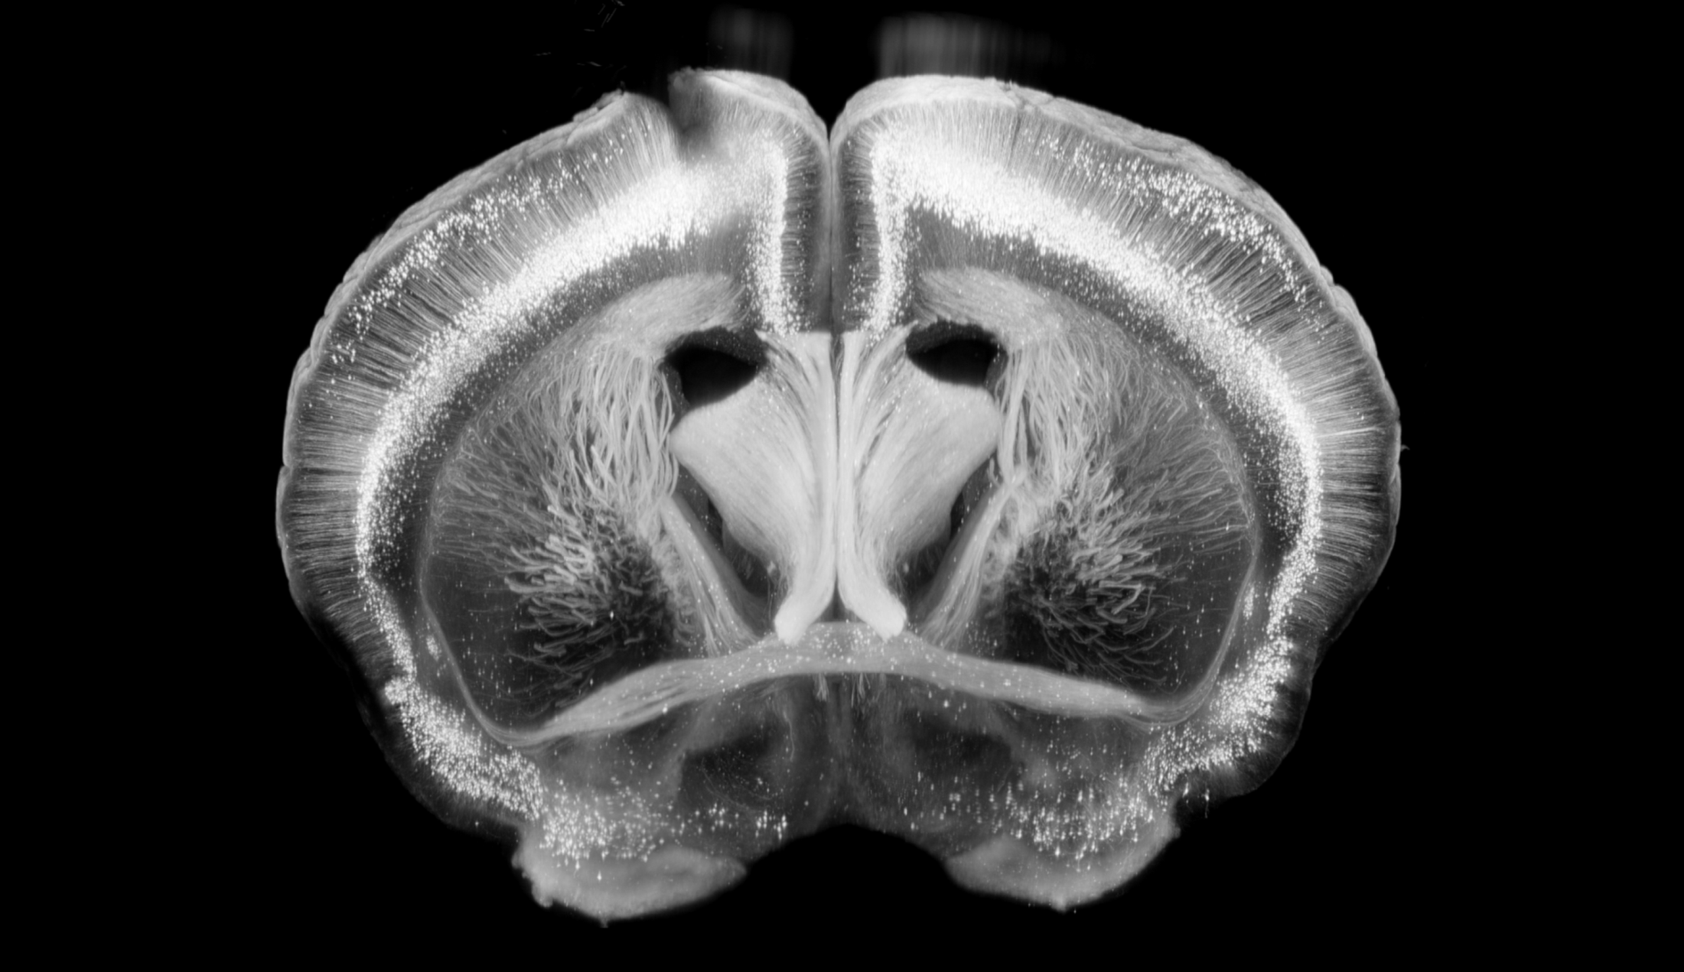
The perils of dual-sided excitation
Note Sep 11th, 2017: Coalignment depends
on the position of the outer cuvette: Do
Not move the outer cuvette after coalignment
For now!
Lightsheet 1
Lightsheet 2
Z direction:
Acquisition movement
of a stack
XZ reslice of a Thy1-YFP dataset
Notice the doubled cells in z because the two
lightsheets can become locally misaligned to
to index-mismatches inside the sample

Slide 11
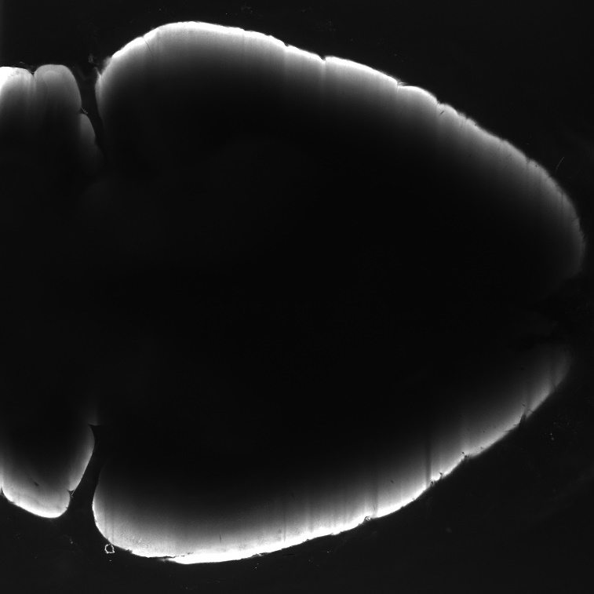
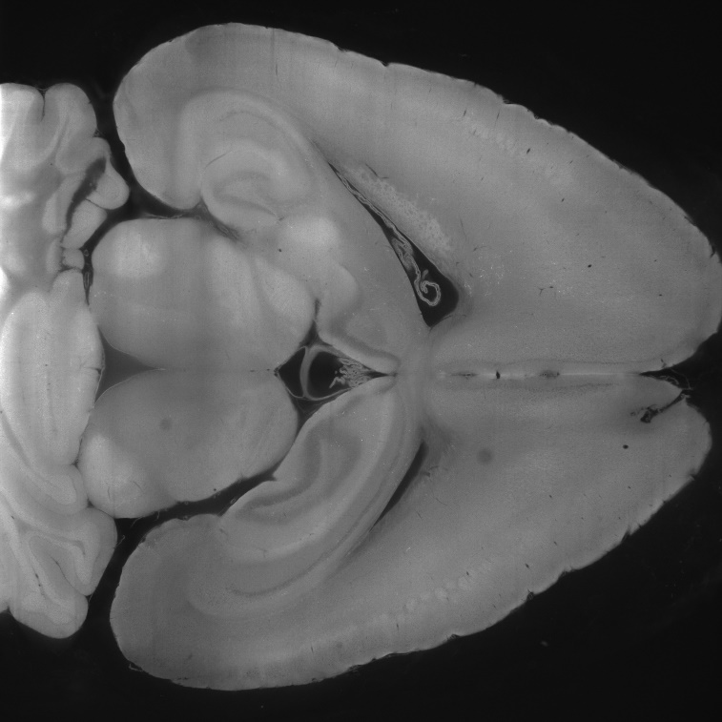
Light-sheet penetration is stongly wavelength-dependent
Right
Bottom
Top
Left
405 nm + Quadrupleband
647 nm + Quadrupleband

Slide 12
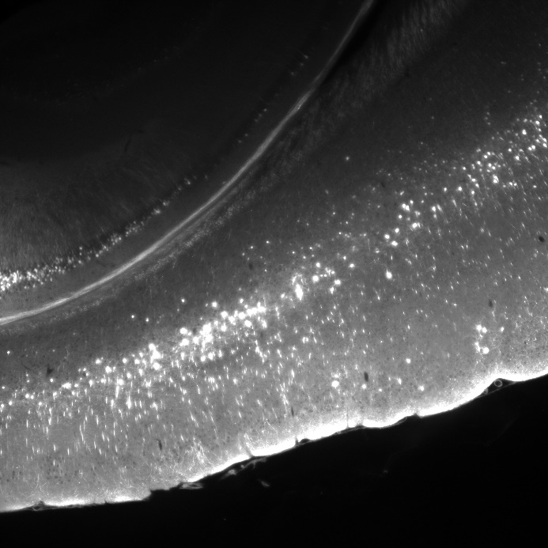
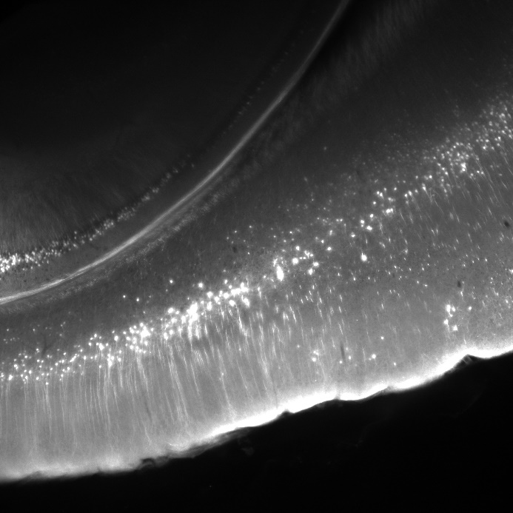
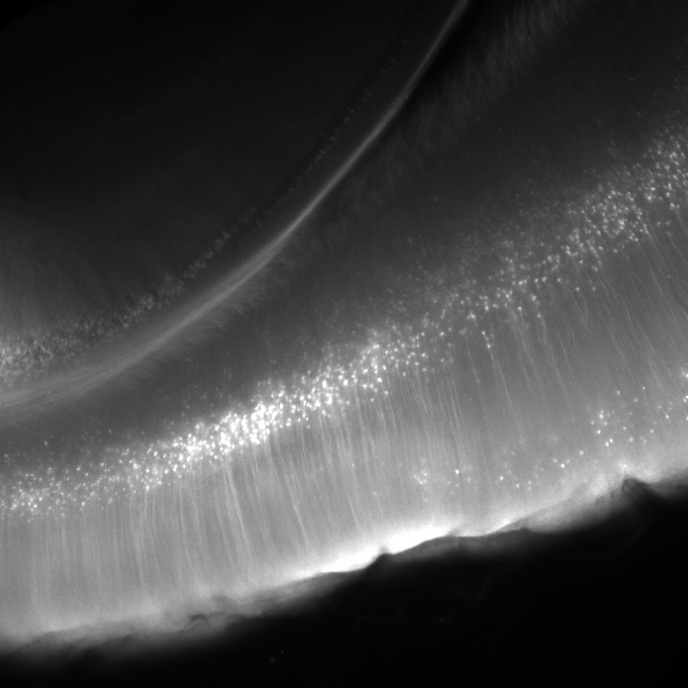
What happens if the tunable lens parameters are incorrect?
A thicker light-sheet leads to more features being visible at the expense of contrast
Thy1-YFP (H-line), 488 nm excitation, zoom 4
ETL offset = 2.47 V
ETL amplitude = 0.17 V
ETL offset = 2.47 V
ETL amplitude = 0.0 V
ETL offset = 2.2 V
ETL amplitude = 0.0 V
Counterstained cell-bodies and blood-vessel cross-sections are usually good structures to judge this

Slide 13
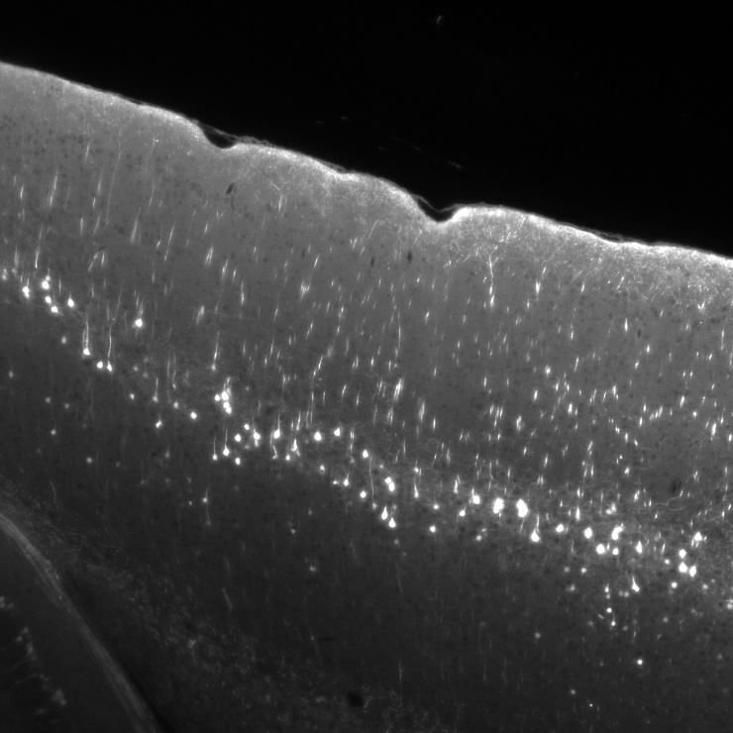
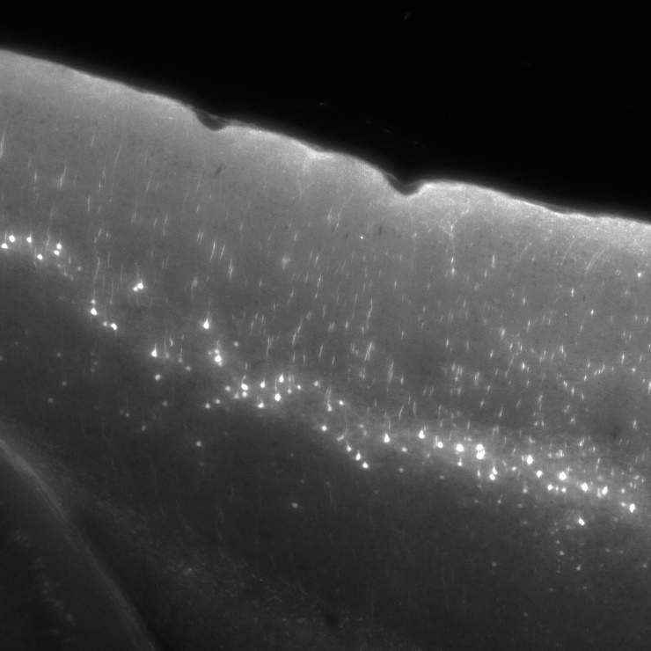
What happens if the path length is to large?
Thy1-YFP (H-line), 488 nm excitation, zoom 6.3x
Thy1-YFP (H-line), 488 nm excitation, zoom 6.3x
To detection objective
Move outer cuvette
by 20 mm
Select a position of the outer cuvette that minimizes spherical aberration while offering enough space for sample movement during stacks & rotations

Slide 14
Part IV: User Interfaces

Slide 15
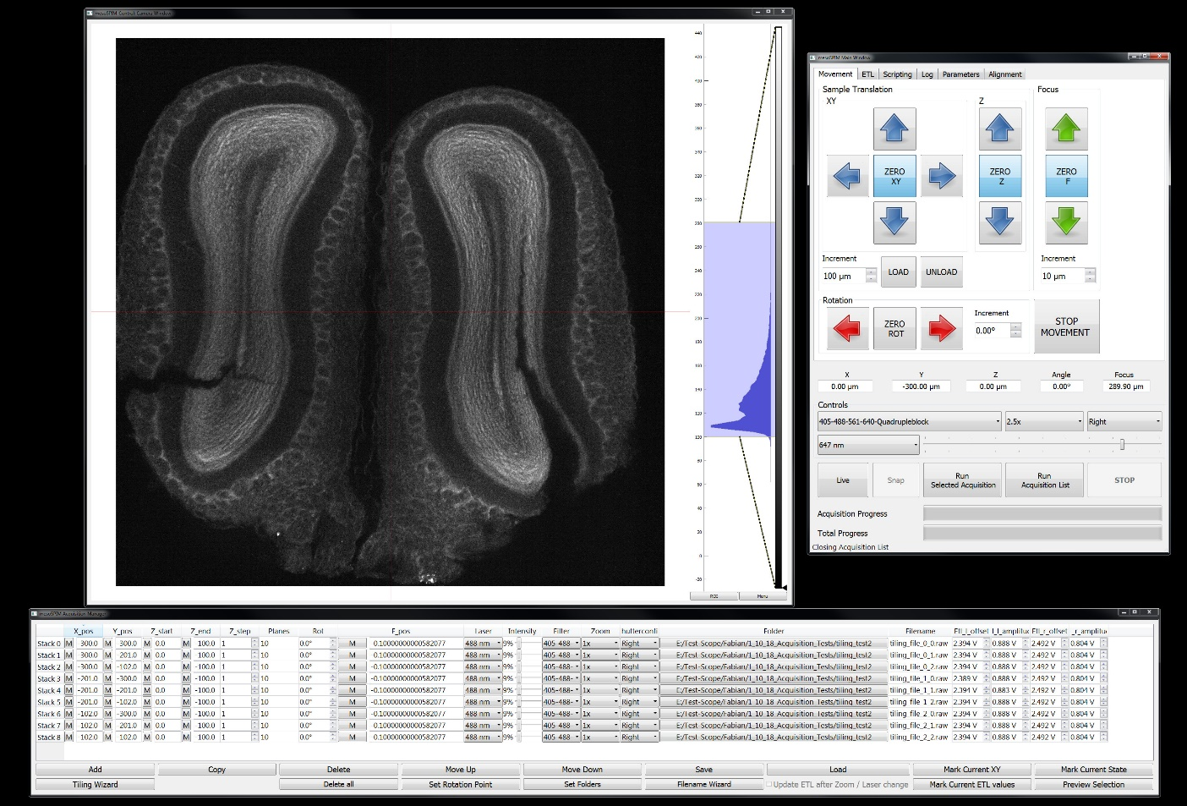
mesoSPIM-control: Overview
Camera
Window
Main
Window
Acquisition
Manager

Slide 16
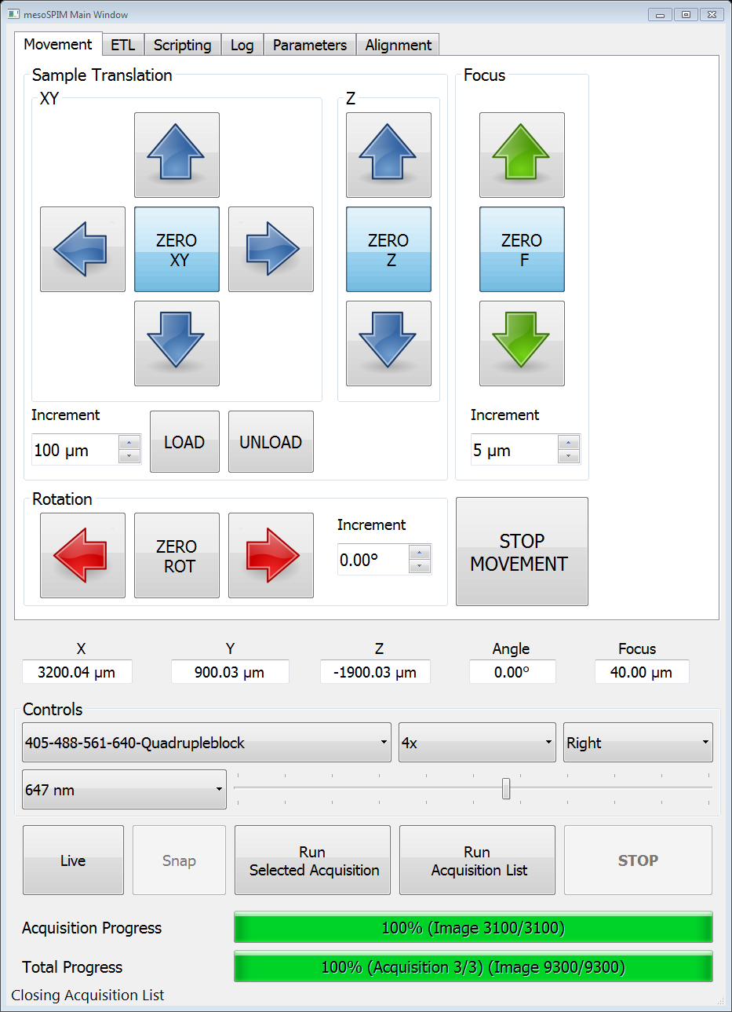
mesoSPIM-control: Main window: Movement tab
Movement
arrows
Sample loading and unloading
(Endpoints can be set
In the config file)
Increment selector
for the movement
Zoom selector
Lightsheet direction
Coordinate readout
Filter selector
Laser selector
Imaging mode buttons
Progress bar for the current acquisition
Progress bar for the list of acquisitions

Slide 17
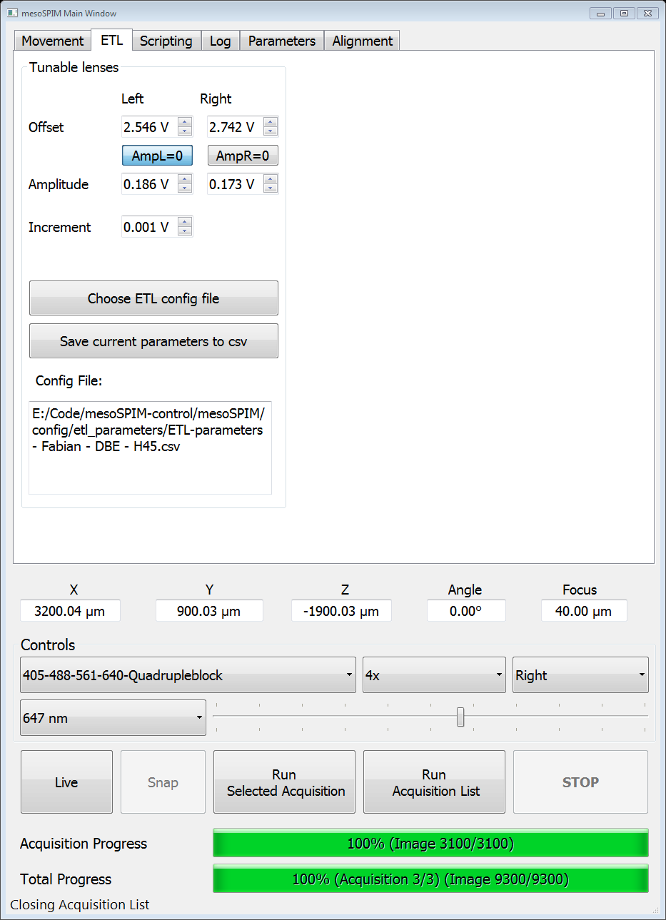
mesoSPIM-control: Main window: ETL tab
ETL offset and amplitude
Buttons to set ETL
Amp to 0 (saves last
amplitude)
Buttons for choosing a
ETL config file & saving parameters
Increment selector for ETL parameters
(especially for mouse wheel usage)
Config file indicator

Slide 18
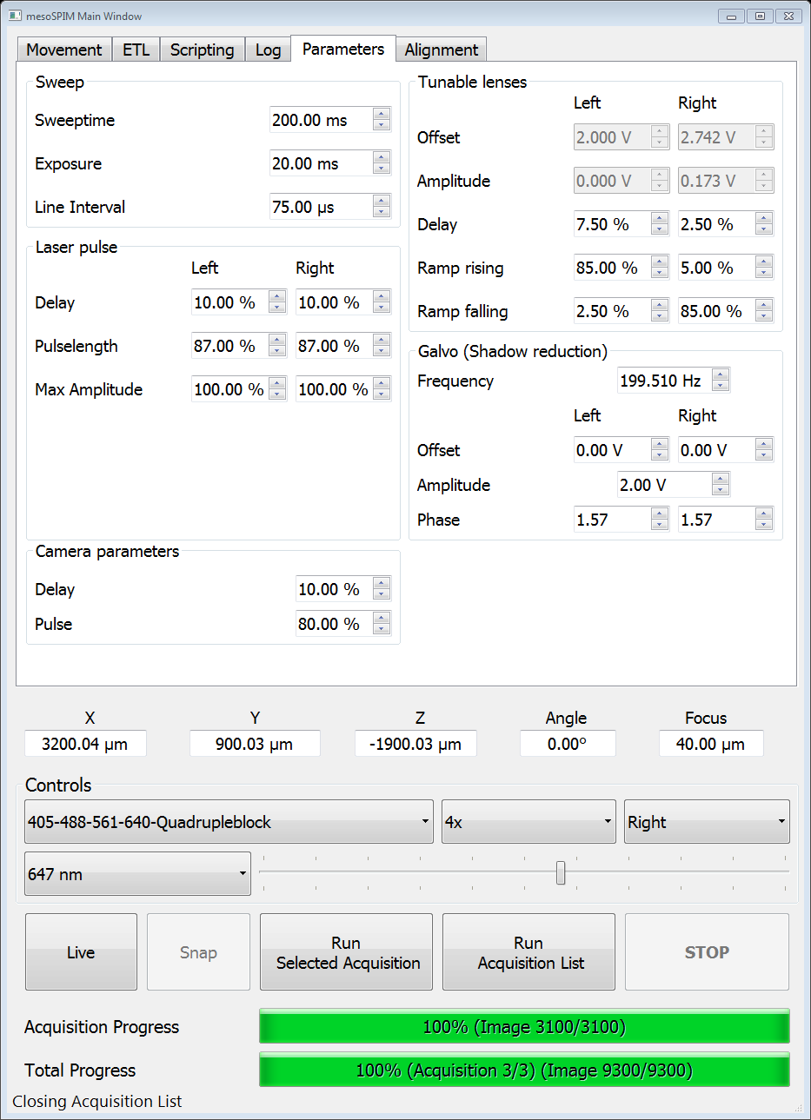
mesoSPIM-control: Main window: Parameters tab
Camera exposure &
Line interval
Galvo parameters

Slide 19
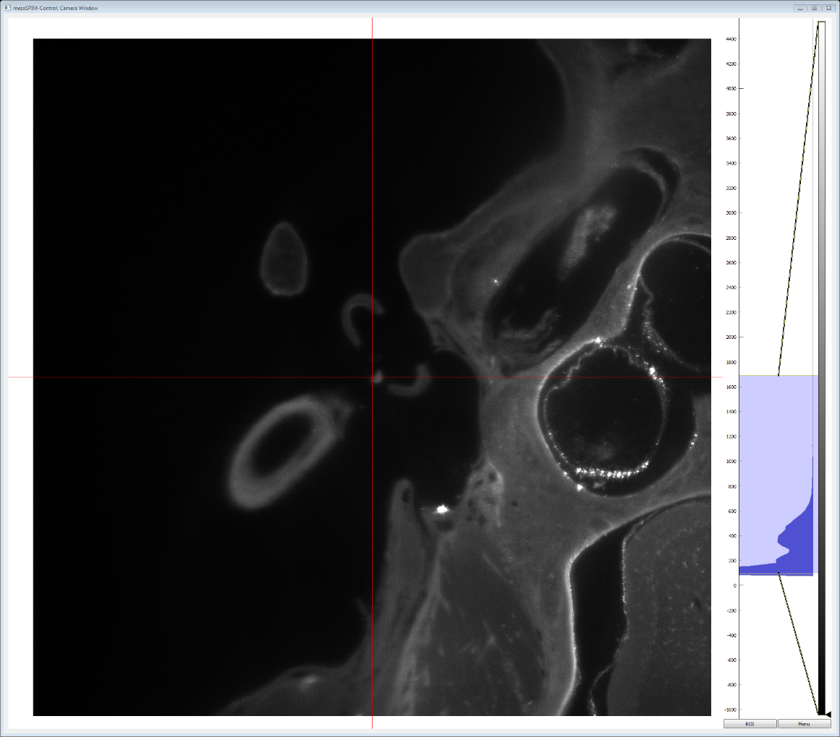
mesoSPIM-control: Camera window
Histogram:
Mousewheel zooms
Right click on the histogram:
Set range / autorange
Right click on the colorbar:
Select lookup table
Main camera window
With crosshairs for
ETL alignment
Mouse drag: Moves
View
Mousewheel: Zoom in/out
(not the motorized zoom)

Slide 20
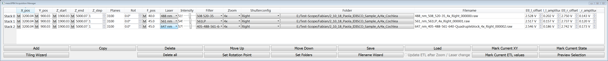
mesoSPIM-control: Acquisition Manager
The acquisition manager replaces the old stack tab in the main window A single row in this table describes an entire stack, the microscope acquires them one-by-one from top to bottom
The parameters shown in the table are the ones used for the respective acquisition, not the ones shown in the main window
When specifiying acquisitions, the stages should only be zeroed once, so that different stacks refer to the same coordinate system!

Slide 21
mesoSPIM-control: Acquisition Manager
Controls for table entries
Save & load tables
Update parts of a selected
table entry & preview
Tiling wizard
Set rotation point
(For an acquisition list) – set
a location where the sample
can rotate without damage
(not fully supported yet)
Set folder for all rows
Autogenerate filenames

Slide 22
Part V: Startup

Slide 23
Startup procedure
Switch L+R Shutters & Galvos on & Activate Galvos! (long press on the enable button till the second light blinks shortly)
Switch Laser + Camera on
Start mesoSPIM-control.py (in a console: «python mesoSPIM-control.py»)

Slide 24
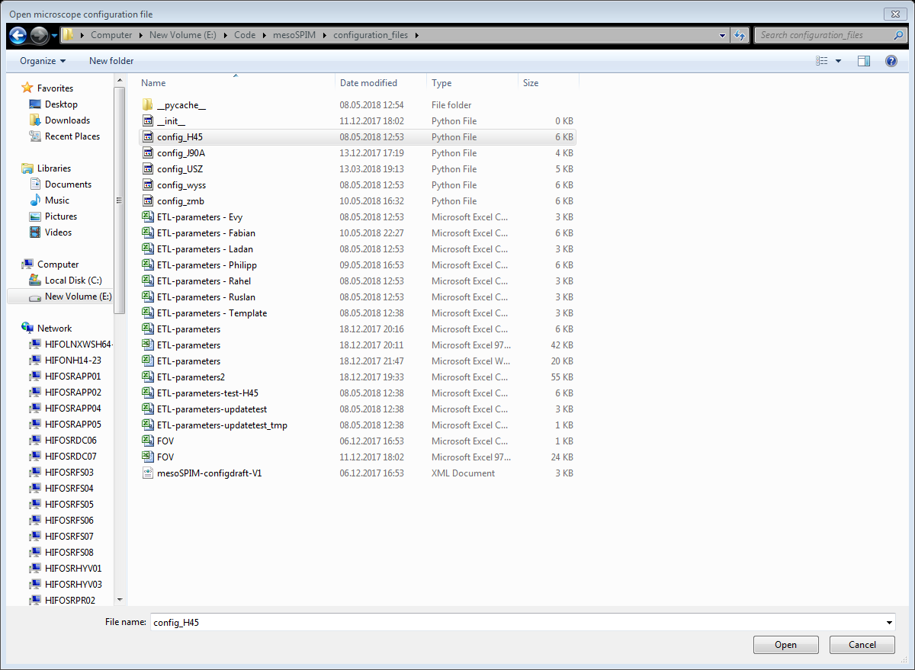
mesoSPIM-control: Startup I
Choose config file according to your setup. This is a .py file containing the microscope configuration, NOT a ETL-parameter file.
The software takes 10-15s to start while performing a reference move with the focusing stage

Slide 25
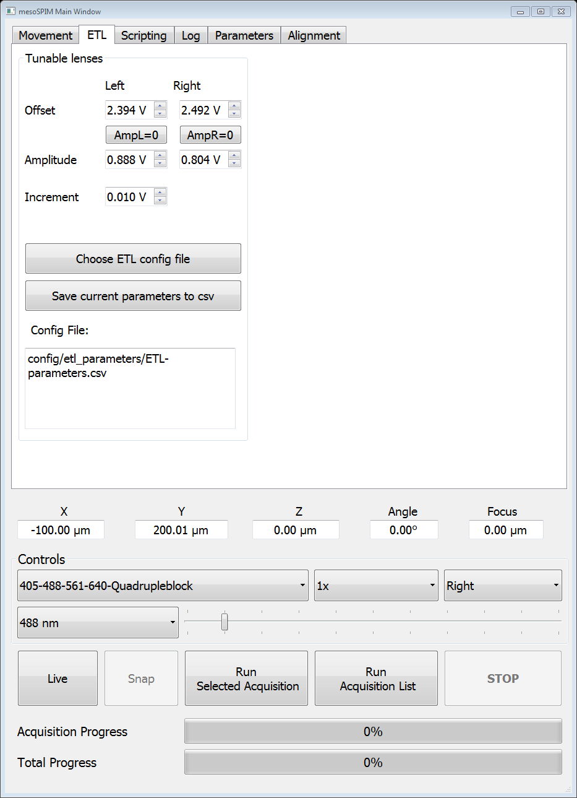
mesoSPIM-control: Startup II
3. Select your ETL parameter file

Slide 26
Part VI: Joystick

Slide 27
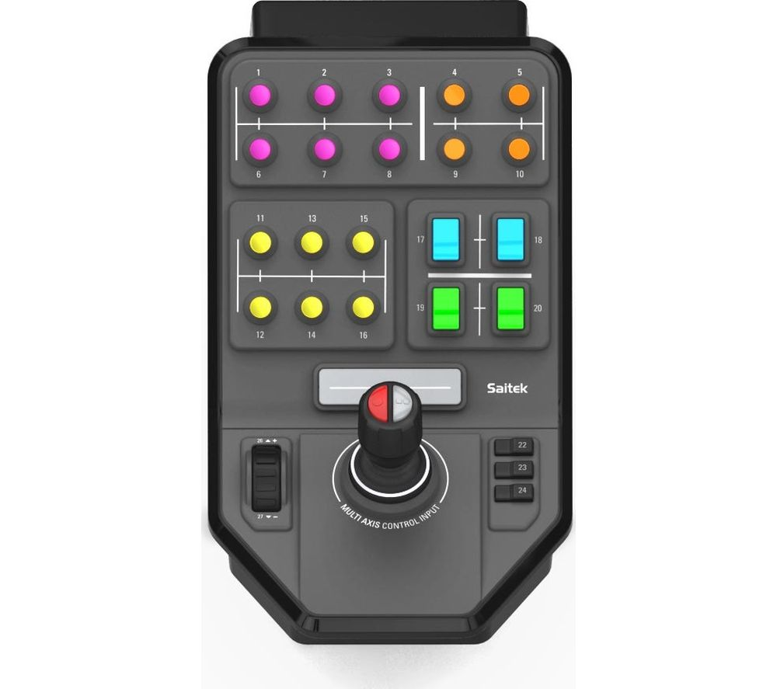
5: Unload
Lasers 1-6
(or 1-4)
10: Load
17: Both Shutters
28: Both Shutters
11 & 12: Increase & decrease Filter
13 & 14: Increase & decrease Zoom
15: Zero XYZ
16: Zero Focus
19: Left Shutter
20: Right Shutter
21: Live/Stop Live
Stop Motion
Stack controls currently deactivated
Laser
intensity
BLUE:
Joystick X (Left-Right): Sample X
Joystick Y (Top-Down): Sample Y
RED:
Joystick X (Left-Right): Focus
Joystick Y (Top-Down): Sample Z
Joystick Twist: Fine Focus

Slide 28
Part VII: Typical acquisitions

Slide 29
Live Mode
1. Click Live in the mesoSPIM Control software
2. Stop Live in the mesoSPIM Control software
When using different lasers/filters, refocusing is
often necessary
Be aware of bleaching – in light-sheet microscopy,
you bleach a plane into your sample

Slide 30
Setting ETL parameters
Go to ETL tab, go to Live mode, select desired lightsheet.
Select the correct user-ETL-config file.
Toggle the AmpL or AmpR=0 button to see the waist location
Using the scrollwheel of the mouse, scroll the offset value so that the waist is in the center of the FOV (on the red crosshair line in HCImage if the crosshair is switched on). It the value changes to quickly, reduce the increment setting.
Toggle the AmpL or AmpR-button again. If desired, the amplitude can be optimized by scrolling and selecting the thinnest light-sheet (fewest sample features visible)
If desired, save the settings for this zoom & wavelength
ETL parameters depend on the mounting medium, its temperature, zoom, and excitation wavelength
The ETL config file provides reasonable presets, but its accuracy should be checked in each sample
When changing the excitation laser or zoom, the ETL parameters will update from the config file. If the chosen values should be retained, save them.

Slide 31
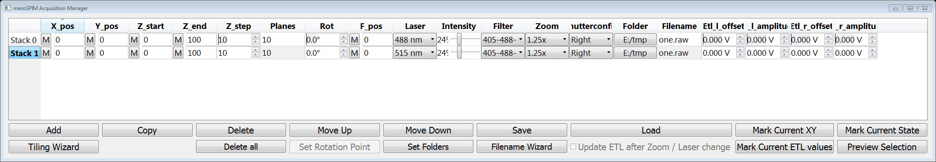
Acquiring stacks / lists of acquisitions
When using different lasers/filters, refocusing is often necessary
Zero the stages (XY, Z, Focus) in live view in an appropriate location
The ETL values for each row are
the ones used for this stack, not the ones
in the Main Window ETL tab.
When creating an acquisition list, never zero different rows at
different locations!
2. Using the mark buttons, select the X,Y,Focus, Z_start and Z_end positions
To stop an acquisition, click «STOP» in the main window
Mark buttons («M»)
Acquisition lists with varying rotations («multiview»)
are currently disabled.
Data is saved as raw image streams, the «.raw» file extension should be used
3. Using the mark buttons, select the X,Y,Focus, Z_start and Z_end positions
Mark X + Y position
For a selected row
4. Select, laser, intensity, filter, shutter for a row
Select a folder for the stack to be saved in by clicking on the button in the folder column. The current folder will be displayed. Using the «Set Folders» button, the folders for the entire table can be changed at once. You can autocreate filenames using the filename wizard.
6. In Live view, you can change your ETL values and then copy them to a selected row using «Mark current ETL values»
7. Using «Mark current state», you can copy the current laser, filter, intensity, zoom and shutterconfiguration from the main window
8. If you click «Preview selection», the microscope will move to position in the selected row and set up filter, zoom, laser, ETLs etc
9. Using «Run Selected Acquisition» in the main window, you can run a single stack. Using «Run Acuquisition List» allows to run the entire table

Slide 32
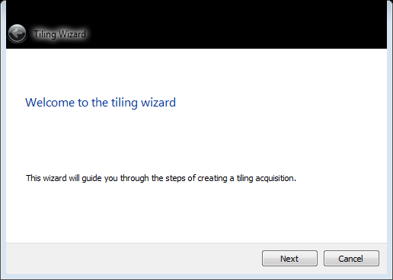
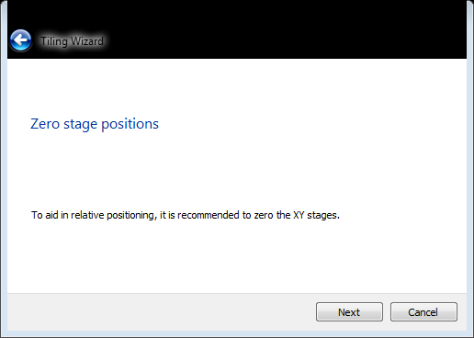
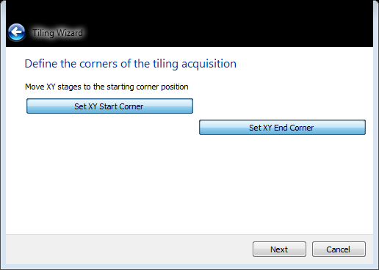
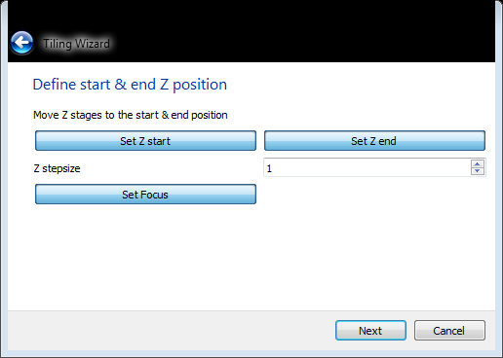
Tiling Wizard
1. Start the Tiling Wizard
2. If desired, zero the stages using the
buttons in the main user interface
3. Set the corner positions (go to live mode &
set positions)
4. Define Start & End Position & Focus
For some reason, screenshots
have a «black bar» on top (not
visible in the window during usage)
Start
Offset
«Offset» is the mechanical
FOV-to-FOV (∆X or ∆Y) movement distance
You have to calculate offset depending on your FOV
The first FOV is centered
on the start position
End
The last FOV contains the
End position (not centered)

Slide 33
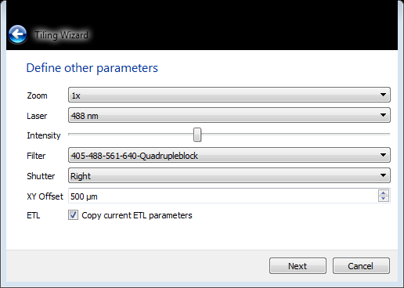
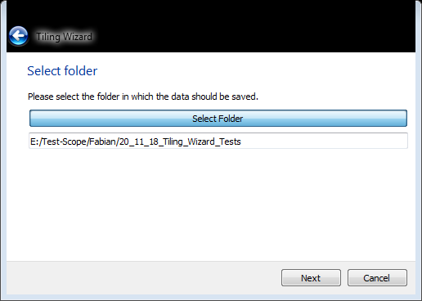
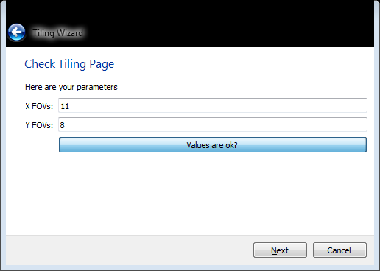
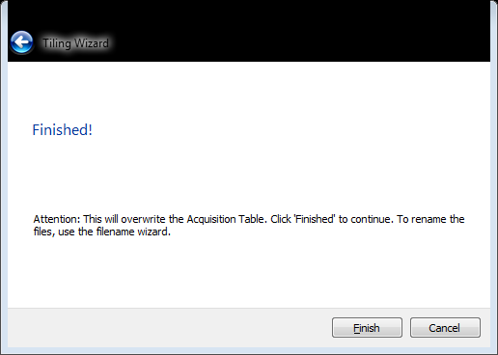
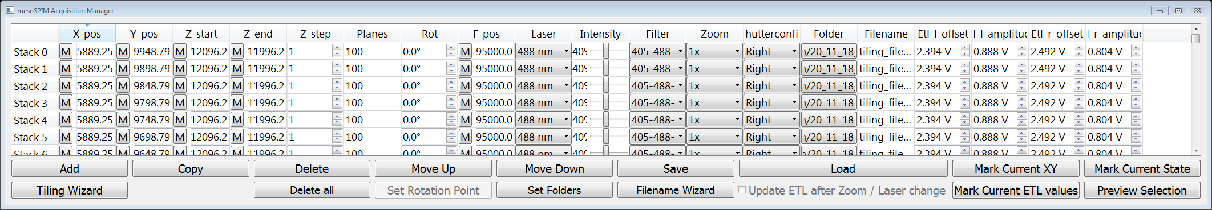
Tiling Wizard
5. Define other imaging parameters
6. Define Folder
7. Check FOV counts:
8. Finished!
9. Enjoy your table – if, necessary, change filenames using the file wizard
10. Modify your table before scanning, for example by checking ETL parameters

Slide 34
Acquisition checklist
General
Sample does not collide at the end positions?
XYZ Zeroed properly?
Focus zeroed?
Noted down the absolute coordinates of the origin (to zero properly before crashing)
X/Y/Z coordinates make senses?
Last minute
No last-minute manual focus changes?
No last-minute changes in Laser, Filter, Intensity, Zoom, Shutterconfig (Left/Right)
Noted down the absolute coordinates of the origin (to zero properly before crashing)
Number of Planes are as desired? No varying z-steps?
No rotations in the list (currently, the software does not accept varying rotations)
Folder selection makes sense?
Filenames are correct?
All ETL values set properly? No default ETL values left?

Slide 35
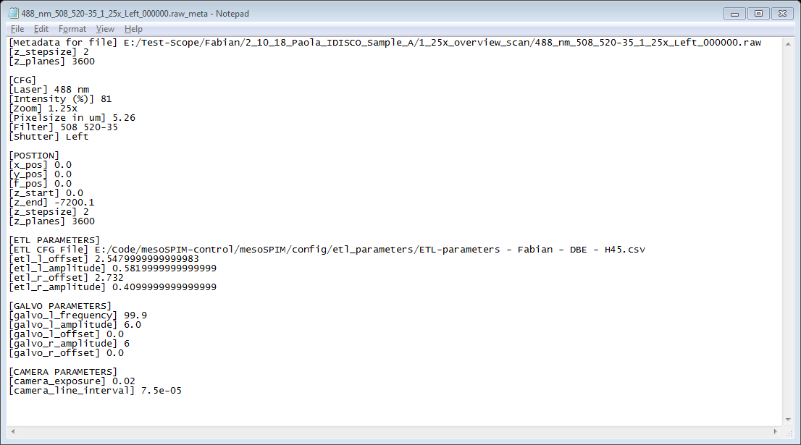
Metadata
For each acquisition, a metadata text file is saved as well which contains the most important parameters

Slide 36
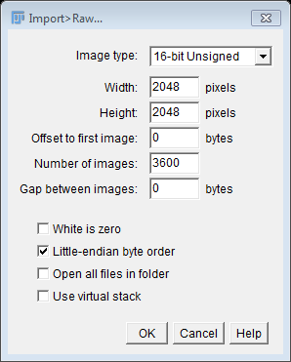
Opening stacks/acquisitions in Fiji
1. In Fiji, select «File» → «Import» → «Raw»
2. A window opens, enter the following parameters:
Height: 2048 pixels
Width: 2048 pixels
Offset: 0 bytes
#Images: according to metadata / larger than acquired
Gap: 0 bytes
Little endian byte order
Number of images can
be larger than the number of acquired images,
the import will work normally
3. The stack will open in the center

Slide 37
Controlling sample rotation
Rotations of a 20 mm cuvette:
0/360º
90º
180º
270º
Detection
Viewed from the top,
positive rotations are oriented
clock-wise
L
R
Lightsheet
Especially when using 20 mm
cuvettes, watch out for collisions with
the outer cuvette!
Position mark

Slide 38
Part VI: Troubleshooting

Slide 39
Typical problems and troubleshooting
Minor Problems
Images are unsharp after changing filters → refocus Microscope Z

Slide 40
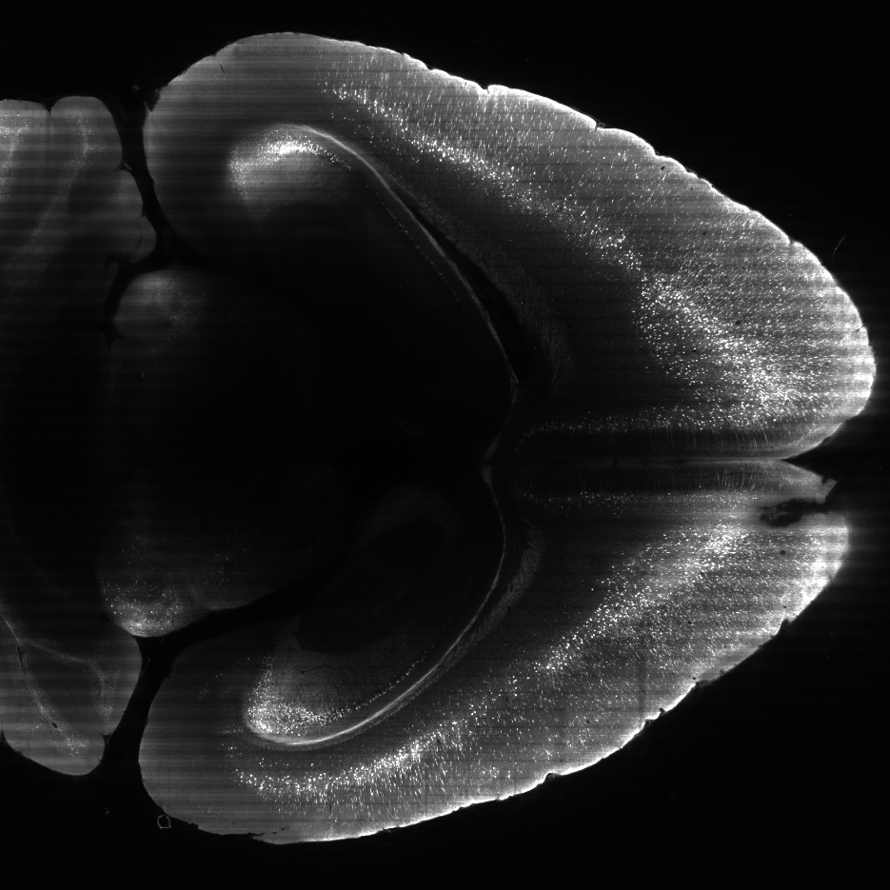
Horizontal Stripes in the image
Stripes indicate that the Galvo
Frequency is not averaged out by the exposure.
Possible reasons:
Wrong Galvo Frequency
Wrong Exposure
Wrong Line interval

Slide 41
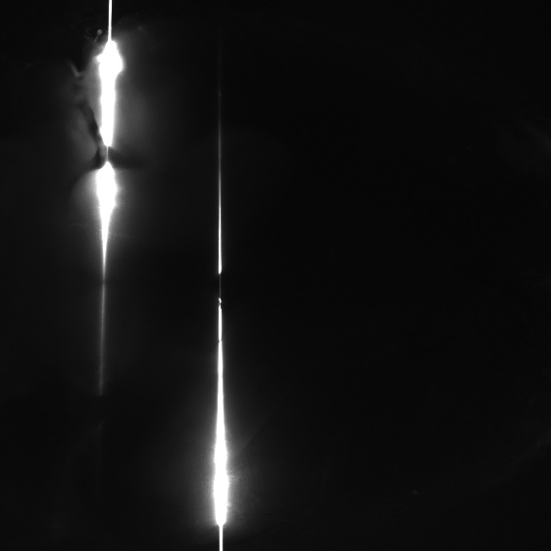
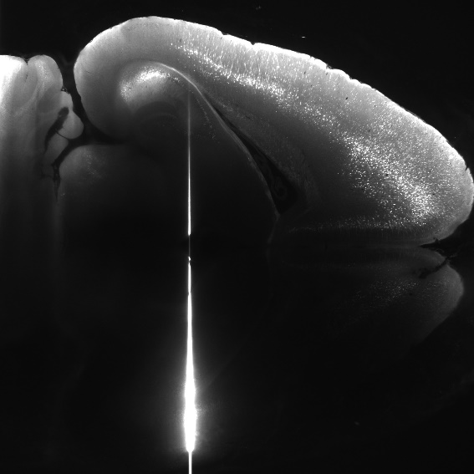
Vertical bright line(s) in the image
One or two vertical lines in the image:
Galvos are switched off
Galvos switched off due to overheating (usually at amplitudes >3.7 V)
Depending on the laser power, this might leave bleached
lines in the sample
→ Turn scanner off and back on (box with red power light)

Slide 42
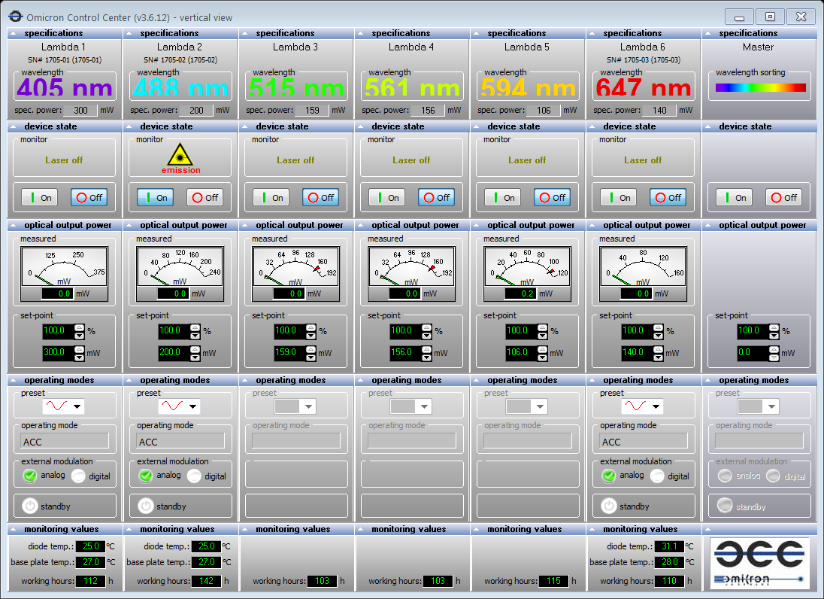
Omicron Control Center: Controlling the lasers (enable/disable)
All six lasers should be displayed, if not, restart the software and possibly
the laser itself (the power switch is on the rear of the laser, left side)
The 515, 561, and 594 nm lasers require some time
after enabling them to warm-up properly .
Enable single wavelengths – ideally, only a single wavelength
is enabled for each stack to avoid co-excitation
During acquisitions, the intensity is controlled via Labview, but currently,
Labview cannot disable a laser completely, so manual

Slide 43
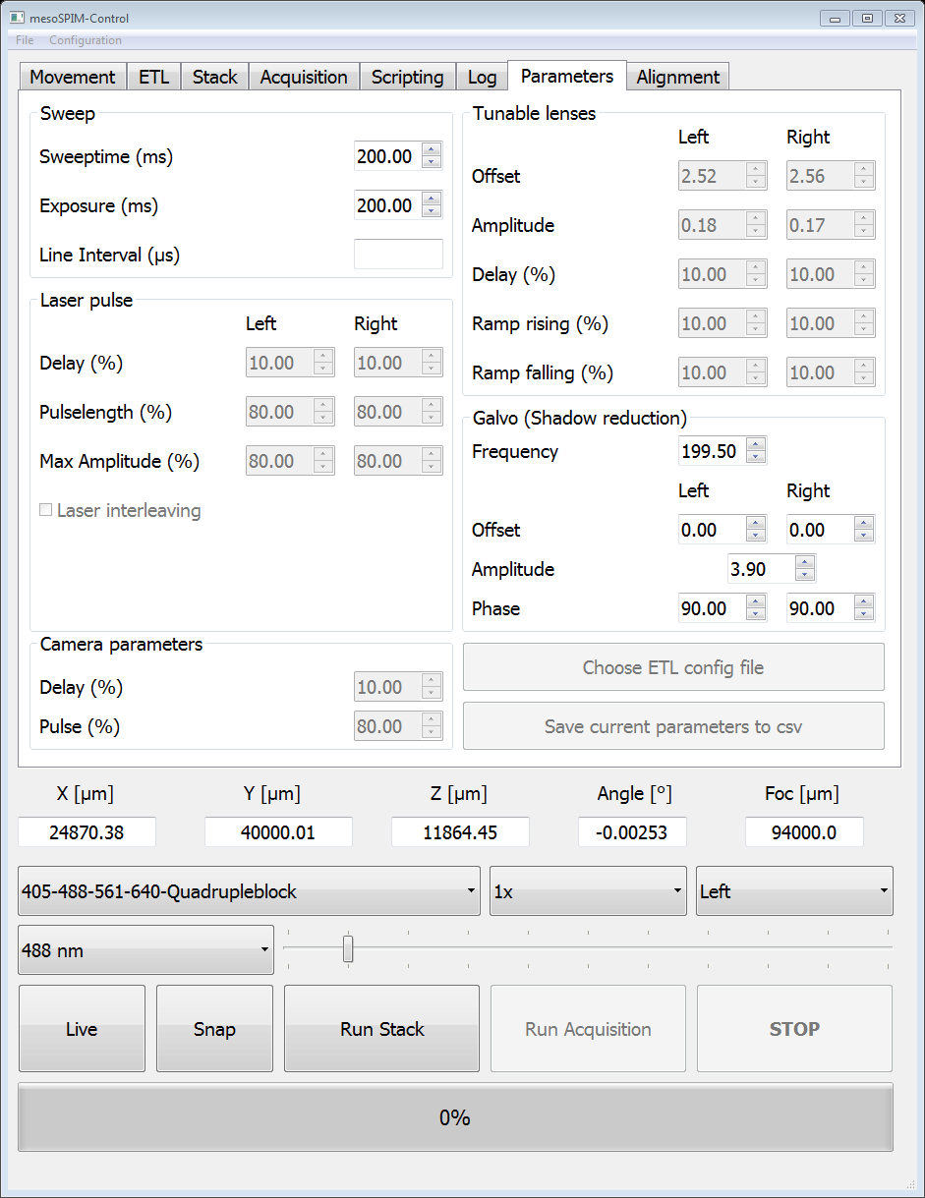
Labview: Galvo Control (Galvo-Sawtooth-6259-OUT.vi)
The Galvos create the lightsheet out of a round beam by scanning vertically. They have to run during all acquisitions.
Start Button (Right arrow)
Central frequency:
@Zoom <1
Frequency 99.5 Hz
Amplitude 5V
@Zoom 1.25
Freq 199 HZ
Amplitude 3.67 V
@Zoom 4
199 Hz
Amplitde 1.4 V
Galvo Parameters:
defaults for Zoom 1.25x
and higher, do not need
to be changed

